Slide 1



Powering Digital Transformation with Pivotal
Erwan Bornier, Cloud Platform Architect
Notes:
I want to talk to you about cloud native applications, and bringing microservice architectures into production in the enterprise.

Slide 2
Why does Pivotal exist?
Notes:
I want to talk to you about cloud native applications, and bringing microservice architectures into production in the enterprise.

Slide 3


“If you went to bed last night as an industrial company, you’re going to wake up in the morning as a software and analytics company.”
- Jeff Immelt CEO, General Electric
Source: User Summit (2014)

Slide 4


Agile Dev & Data Science
modern, collaborative
TRANSFORMATION
App & Dev Platform:
PCF: modern, cloud-oriented & open
Data Fabric:
BDS: modern, cloud-oriented & open

Slide 5
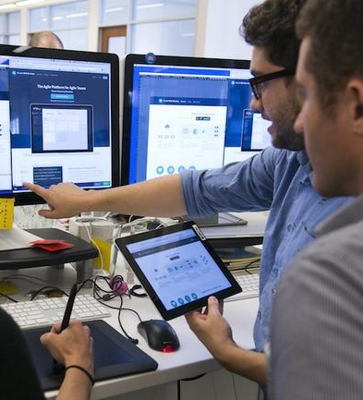
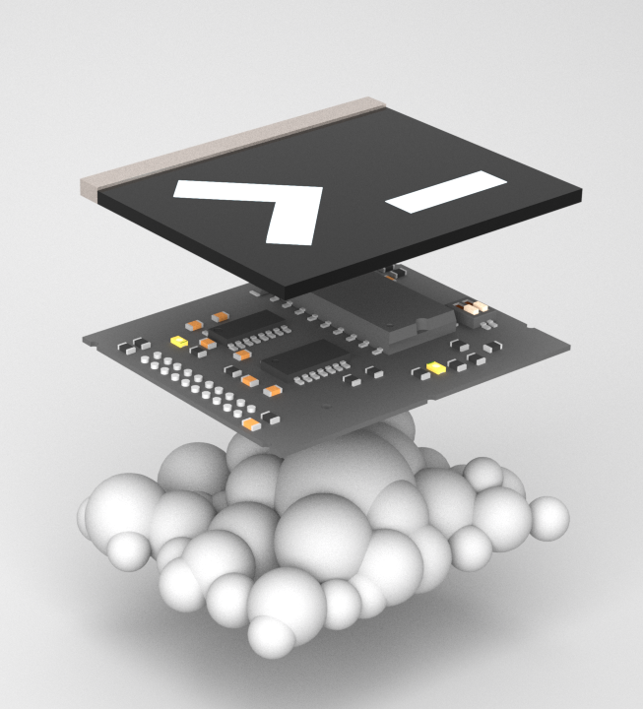


Modern Software Methodology
Modern Cloud Native Platform
Here is my source code,
Build Software with you
Run it in the Cloud for me,
Show you how we do it
I do not care how

Slide 6


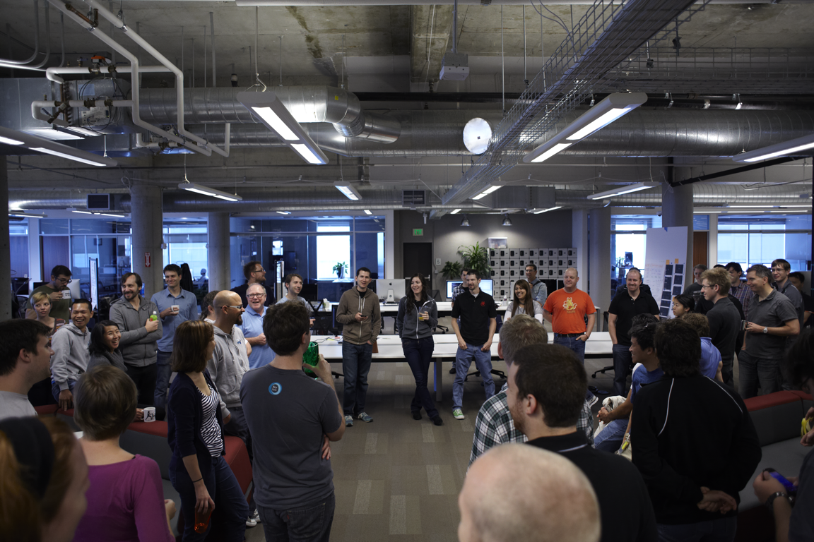
- Learning & Transforming by doing
X
X
Industry’s leading agile software development practice with 25 years experience with innovative startups & Now working with world’s largest enterprises on IT transformation. (GE, Philips, BMW, Daimler, Nordstrom …)
Pre-IPO customers: Google, Facebook, Twitter, Uber, Instagram…
+700 engineers across +12 offices, in order to be physically co-located with our customers
Large Startup Ecosystem (mentoring; partnership …)
*Current Locations: San Francisco, Palo Alto, New York, Chicago, Los Angeles, Boulder, Denver, Toronto, Boston, Melbourne, Tokyo, London
Paris (2016)
Notes:
Let’s start with how we empower the cultural transformation- the people and process side of the equation.

Slide 7
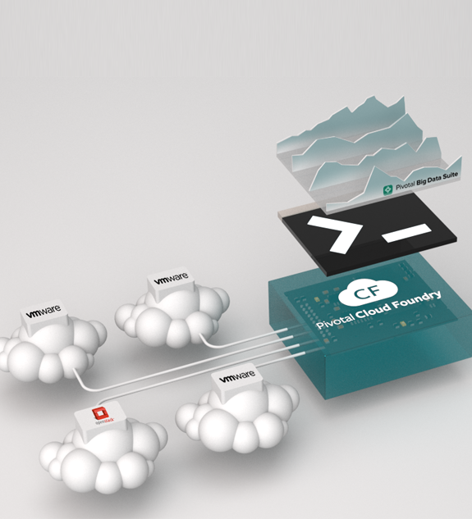

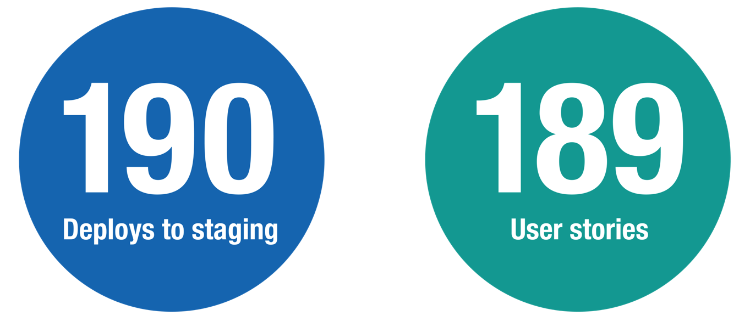
CASE STUDY: DAIMLER
The engine behind the Mercedes-Benz connected car
In less than 3 months project phase

Slide 8
Here is my code
Run it in the cloud for me
I don’t care how

Slide 9
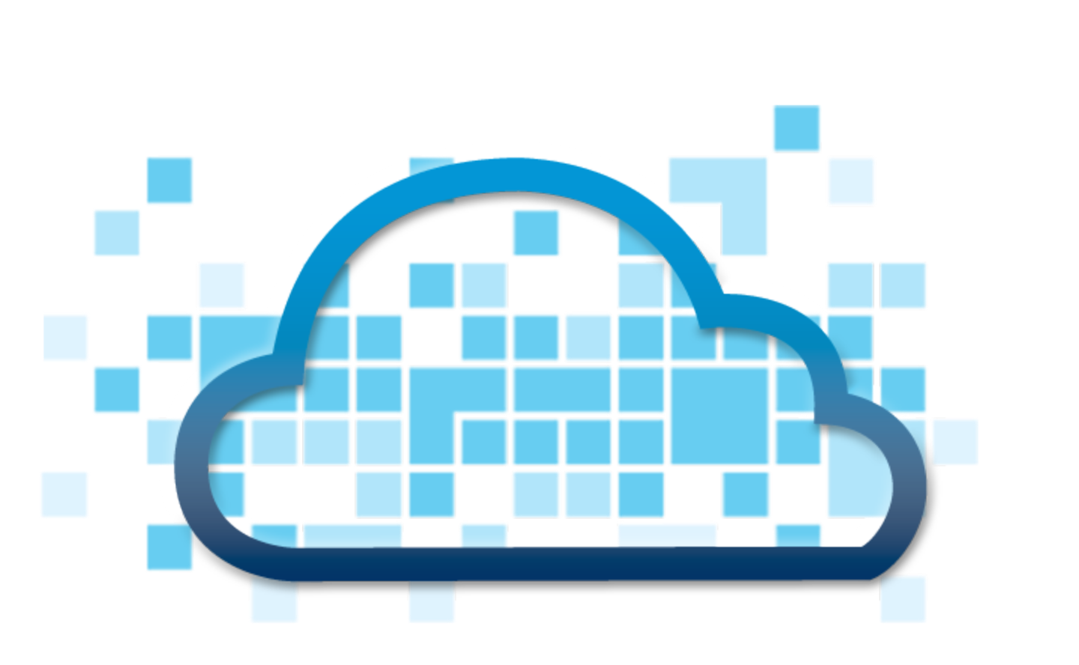
How Did We Get Here?
2009
2011
2013
2014
2010
2012
2015
THE VISION;
DEVELOPERS
BEGIN WORK
OPENING UP R&D, CREATION OF BOSH
PIVOTAL CREATED
OPEN GOVERNANCE, MEMBERSHIP AND FOUNDATION
40+ FOUNDATION MEMBERS
Notes:
Mid 2009: Cloud Foundry development begins
April 2011: Public launch of Open Source PaaS / cloudfoundry.com
April 2012: Public launch of Open Source BOSH
April 2013: Pivotal created from EMC & VMware around SW and OSS assets including Cloud Foundry, Rabbit, Spring, …
February 2014: Announced move to establish open governance Foundation along with seven Platinum Members and two Gold Members
May 2014: Announced expanded Foundation Gold Membership with the addition of eight new companies
June 2014: Announced doubling of Foundation to a total of 35 participants
December 2014: Foundation launch

Slide 10












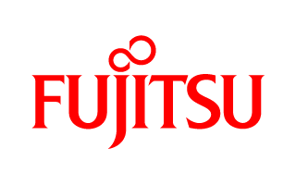

Cloud Foundry Foundation: An Open Industry Standard
PLATINUM
GOLD
SILVER
Notes:
This opinionated design has taken off as an open industry standard. The Cloud Foundry Foundation has more than 50 member organizations, from ecosystem providers like Docker and New Relic to customers making big platform investment like GE, JP Morgan Chase and Verizon.
( Updated Nov 2015, latest foundation slide version is always under https://sites.google.com/a/pivotal.io/inside-pivotal-cf/ )

Slide 11
Deliver highly available applications continuously at scale

Slide 12
Continuous
Delivery
DevOps
New Apps
Cloud Native
Legacy Apps
Transformation
Micro services
Containers
Notes:
At Pivotal, we really see these trends as manifestations and facets of the same thing – that we call CLOUD NATIVE.
CLOUD NATIVE is the coming together of tools, frameworks and building modern software on a cloud infrastructure

Slide 13
Culture
Automation
Lean
Measurement
Sharing
Continuous
Delivery
DevOps
Cloud Native
+
Technology
Micro services
Containers
Notes:
At Pivotal, we really see these trends as manifestations and facets of the same thing – that we call CLOUD NATIVE.
CLOUD NATIVE is the coming together of tools, frameworks and building modern software on a cloud infrastructure

Slide 14

Agile &
DevOps
Continuous
Delivery
Cloud Native
Micro services
Containers
Notes:
At Pivotal, we really see these trends as manifestations and facets of the same thing – that we call CLOUD NATIVE.
CLOUD NATIVE is the coming together of tools, frameworks and building modern software on a cloud infrastructure

Slide 15
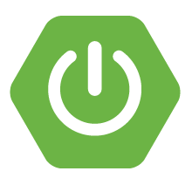
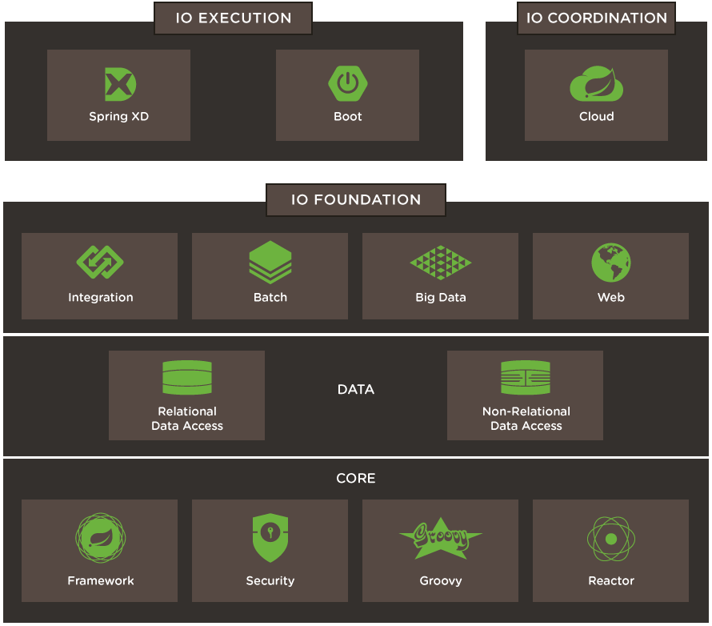
Spring IO EXECUTION: SPRING BOOT
application configuration patterns, microservice container
Java, Spring IO, Groovy
Convention-over-configuration, no XML, no code generation, autoconfigure everything
Opinionated Spring IO that gets out of the way quickly if you want to change defaults
Standalone executable JAR packaging
Autoconfigure / embed app server
Cloud Foundry autoconfiguration
Production ready ops switches out of the box
Project generator at start.spring.io
Notes:
It’s platform aware and provides an integrated spectrum of opinions, convention over configuration

Slide 16
Spring Boot and Spring Cloud Adoption
Cloud Native Framework Adoption
1.65M
1.47M
1.31M
1.18M
1.07M

Slide 17
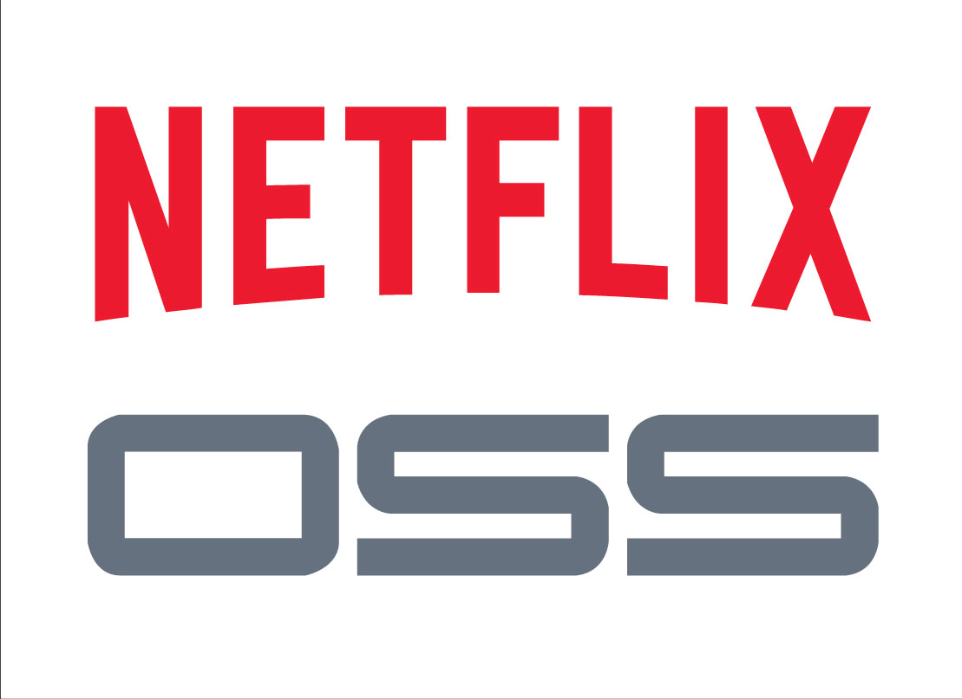
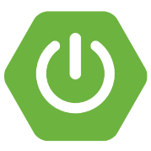
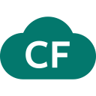
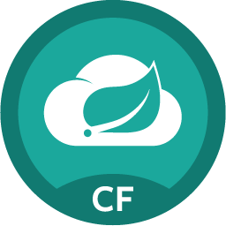
It takes a platform…
Cloud Foundry
Spring Cloud
Services

Slide 18
Agile &
DevOps
Continuous
Delivery
Cloud Native
Micro services
Containers
Notes:
At Pivotal, we really see these trends as manifestations and facets of the same thing – that we call CLOUD NATIVE.
CLOUD NATIVE is the coming together of tools, frameworks and building modern software on a cloud infrastructure

Slide 19
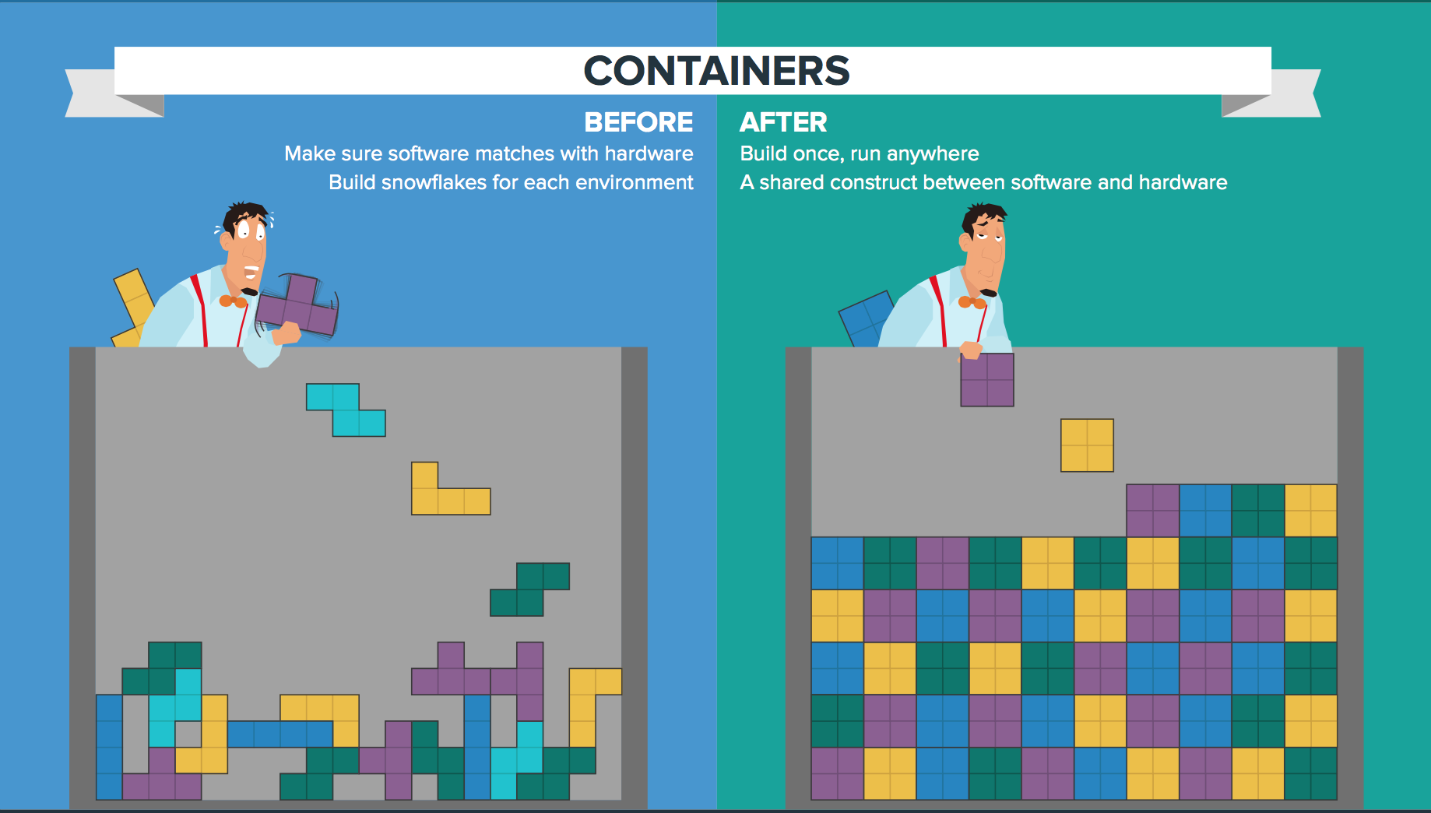
Notes:
At Pivotal, we really see these trends as manifestations and facets of the same thing – that we call CLOUD NATIVE.
CLOUD NATIVE is the coming together of tools, frameworks and building modern software on a cloud infrastructure

Slide 20
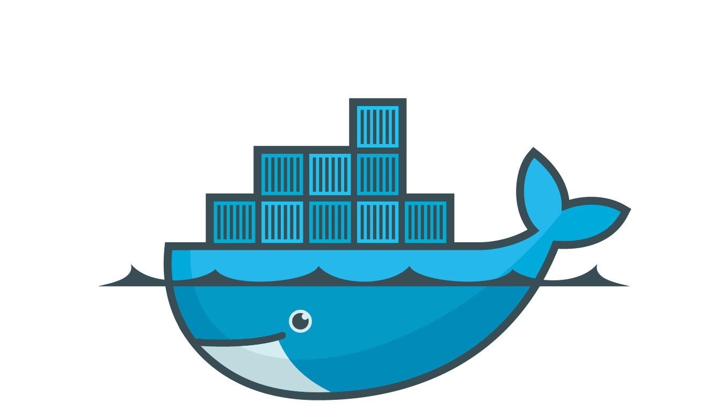

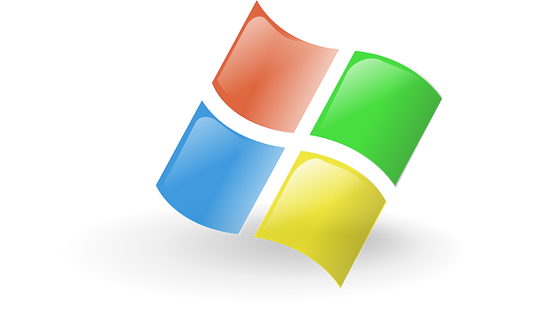
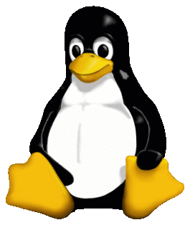


Application-centric container scheduler
BRAIN
BBS
BBS
Services
Notes:
Also, everybody is talking about containers. Pivotal Elastic Runtime is actually one of the most mature linux container scheduling environments in the world.

Slide 21
Agile &
DevOps
Continuous
Delivery
Cloud Native
Micro services
Containers
Notes:
At Pivotal, we really see these trends as manifestations and facets of the same thing – that we call CLOUD NATIVE.
CLOUD NATIVE is the coming together of tools, frameworks and building modern software on a cloud infrastructure

Slide 22
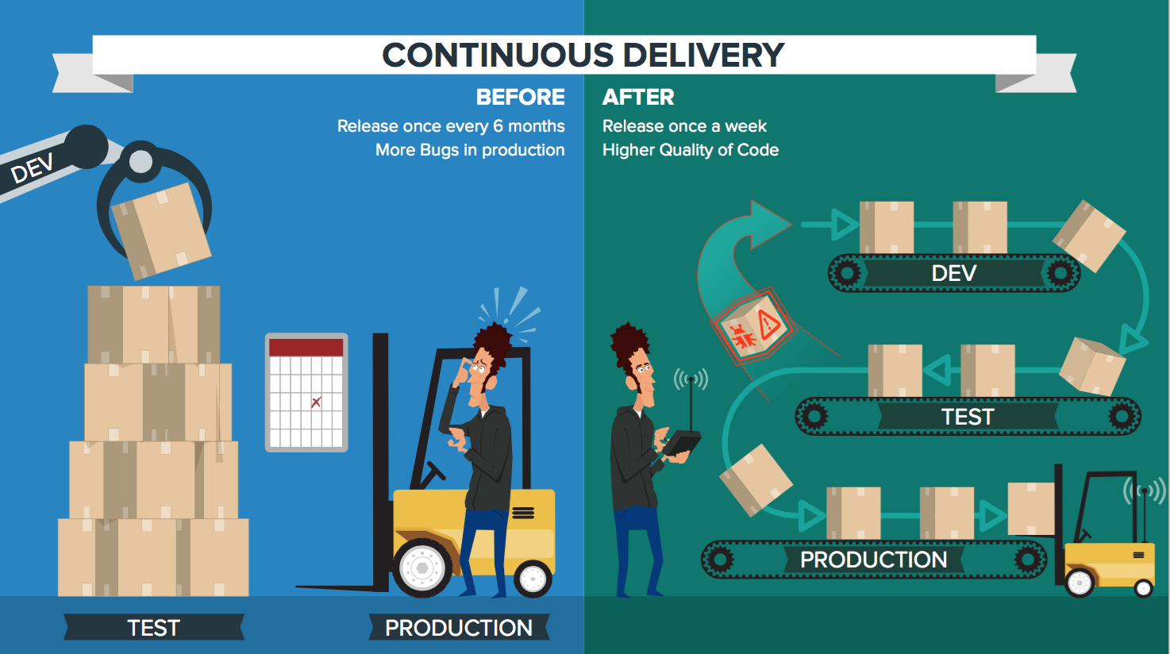
Notes:
At Pivotal, we really see these trends as manifestations and facets of the same thing – that we call CLOUD NATIVE.
CLOUD NATIVE is the coming together of tools, frameworks and building modern software on a cloud infrastructure

Slide 23
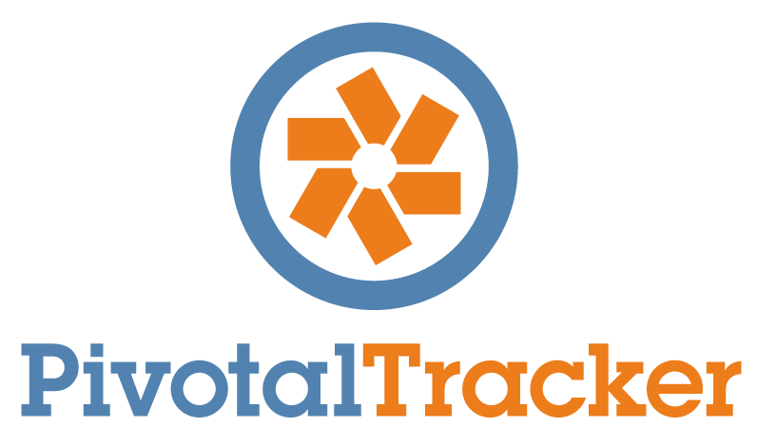
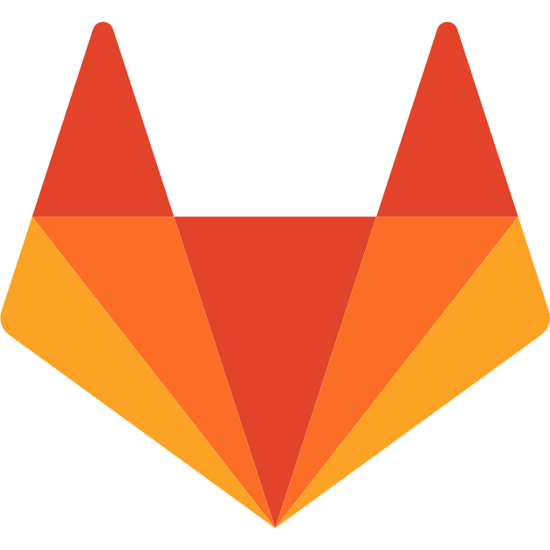
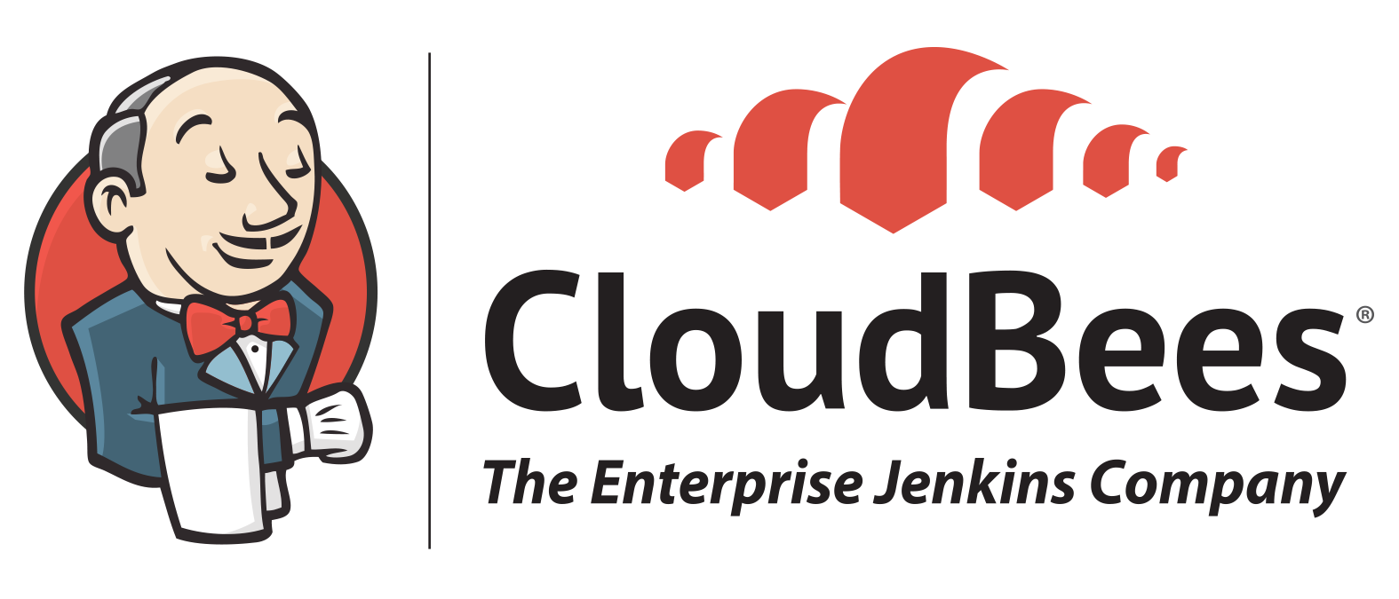
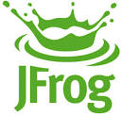
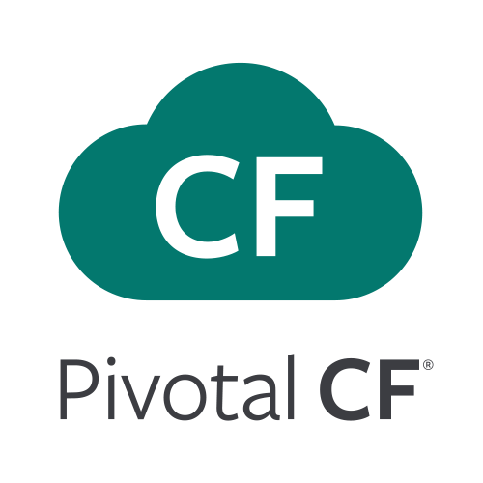

Complete Toolchain for CI/CD High Quality Software, Faster and Continuously From Idea to Production
AUTOMATION.
Integrate tools and automate processes from testing to builds and deployment
SPEED.
Release more frequently with smaller bits will reduce complexity and improve time-to-market
QUALITY.
Reduce feedback loop using test-driven development to surface problems sooner and be responsive
AGILITY.
Push updates on regular basis with no downtime to improve customer experience and time to market
Commit Code Change
Automate Build & Test
(Unit Test, Static Code Analysis)
Store Binaries & Build Artifacts
Automated Integration Testing
Acceptance, Performance & Load
Zero Downtime Upgrade to Production
Build Pipeline Operations
Tool Chain
Gitlab
Jenkins
Development
Test + UAT + Staging
Production
Distributed revision control and source code management. Collaborative software development.
Build, test and deploy software projects continuously and incrementally. Thousands of compatible plugins.
Share binaries and manage distributions. Manage artifact lifecycle.
Develop, test, QA and production on the same platform. Simple, developer friendly commands and APIs. Operational benefits for every app. Built-in ecosystem services. Deploy, operate and scale on any IAAS
Notes:
Although a critical critical element of continuous delivery, the ability to build, test and deploy code quickly and reliably via this toolchain is only half the story. Continuous delivery is a business goal and measured in the delivery of software functionality to customers, not in the delivery of bits to machines. As such, a holistic interpretation of continuous delivery must expand to include production concerns for applications. Only when deployed software can remain scalable, highly available, secure, and updateable in production—all without downtime—should it be deemed “delivered.”
Not only does PCF provide such operational excellence for the applications in production, but it also does so for the GitLab, CloudBees Jenkins and JFrog Artifactory services themselves. Integrating these services for streamlined delivery of code with PCF provides a reliable, turnkey, end-to-end platform for continuous delivery. It’s what enables Pivotal customers to get ideas from conception to production in less than a day, which in this day and age, is a truly strategic advantage.

Slide 24
Agile &
DevOps
Continuous
Delivery
Cloud Native
Micro services
Containers
Notes:
At Pivotal, we really see these trends as manifestations and facets of the same thing – that we call CLOUD NATIVE.
CLOUD NATIVE is the coming together of tools, frameworks and building modern software on a cloud infrastructure

Slide 25
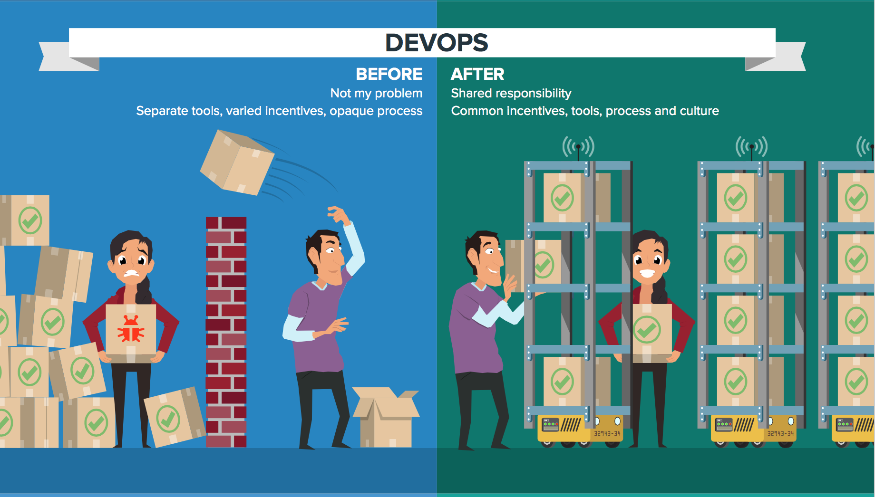
Notes:
At Pivotal, we really see these trends as manifestations and facets of the same thing – that we call CLOUD NATIVE.
CLOUD NATIVE is the coming together of tools, frameworks and building modern software on a cloud infrastructure

Slide 26
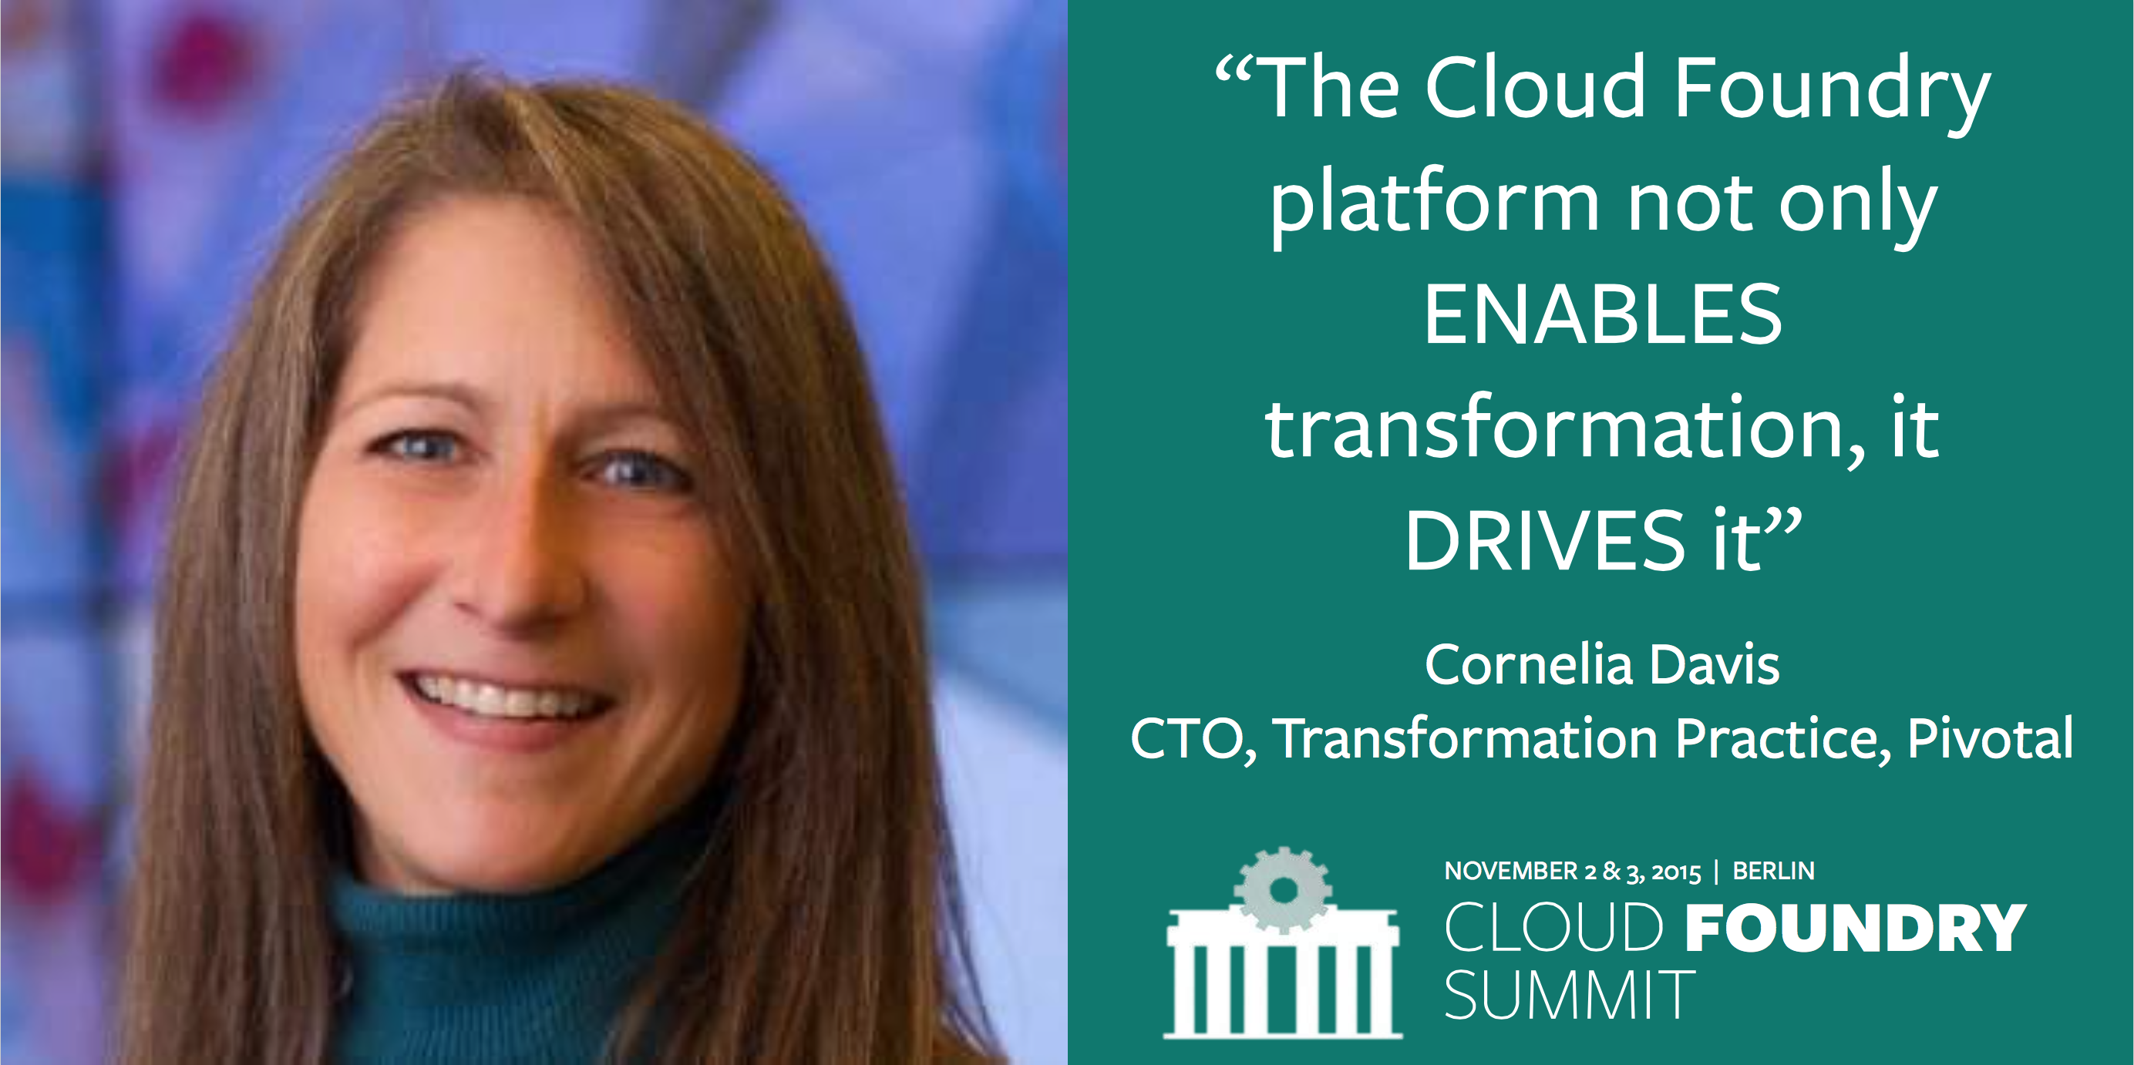
Notes:
And here’s the reality.
You have a precious resource that’s spending TOO much of their time, not doing what you hired them to do. And for good reason.

Slide 27

Platform Runtime
Services
Routing
Container Scheduling
Service Discovery
Configuration
Database
Application Framework
Big Data
12 Factor Apps
Microservices
RESTful Services
Circuit Breakers
Continuous Delivery
Mobile
Spring Boot
Ruby on Rails
Node.js
.NET
Build CI
Logging & Metrics
Quota
User Provided
Operations
Zero Downtime Deployments
Failover & Recovery
Scaling
Security Patching
Platform
Upgrades
Infrastructure
Autres Cloud
VCloud Air
VSphere
Notes:
Let’s go into a little more detail about the components that actually make up Pivotal Cloud Foundry.
We the applications, which is where this starts. You need to select an application framework that lets you build these distributed systems.
We have a platform runtime, which handles routing etc. Attachable backing services for data, CI, and whatever your need
This is built on an operations layer
It does all this on Vmware and Openstack in your data center, plus Amazon public cloud. If each of those infrastructures was an electricity grid, Cloud Foundry would be the travel adapter. You get a single deployment API and set of backing services, so you can port applications with no code changes.
It comes down to this: Would you rather have developers spend their time building a platform, or using one?
Dev and Ops teams have to change together
Our customer base was struggling with partial transitions and continuous delivery

Slide 28
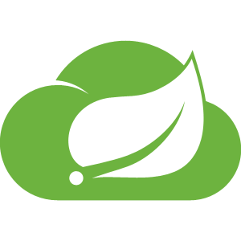
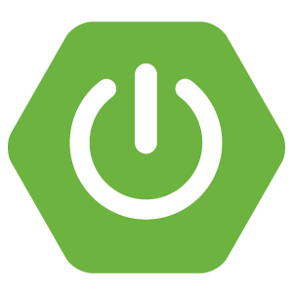
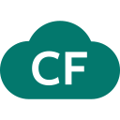
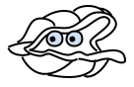
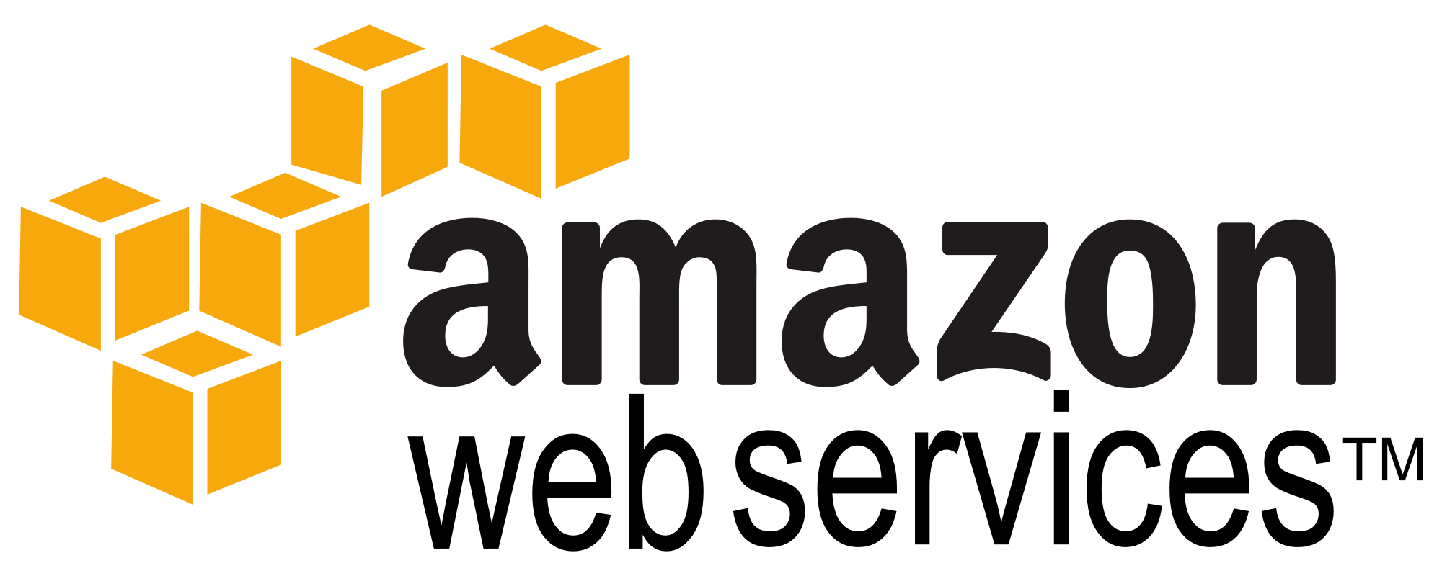
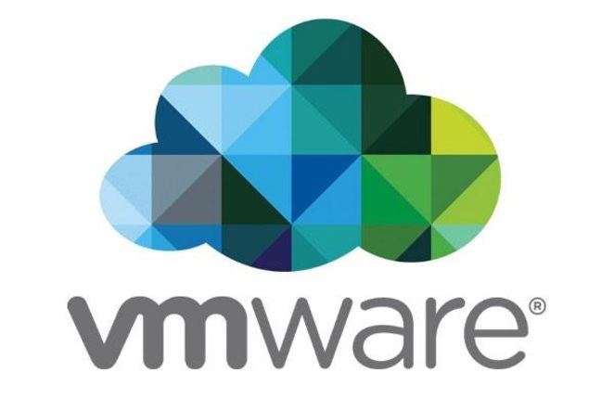

Culture
Cloud Native Framework
Tools
Application Framework
Spring Cloud
Spring Boot
Dev
Runtime Platform
Dev
IT Ops
Cloud Foundry
Infrastructure Automation
IT Ops
BOSH
Infrastructure
IT Ops
AWS
VMWare
OpenStack
Notes:
The Application framework is all about letting developers focus on building software.

Slide 29
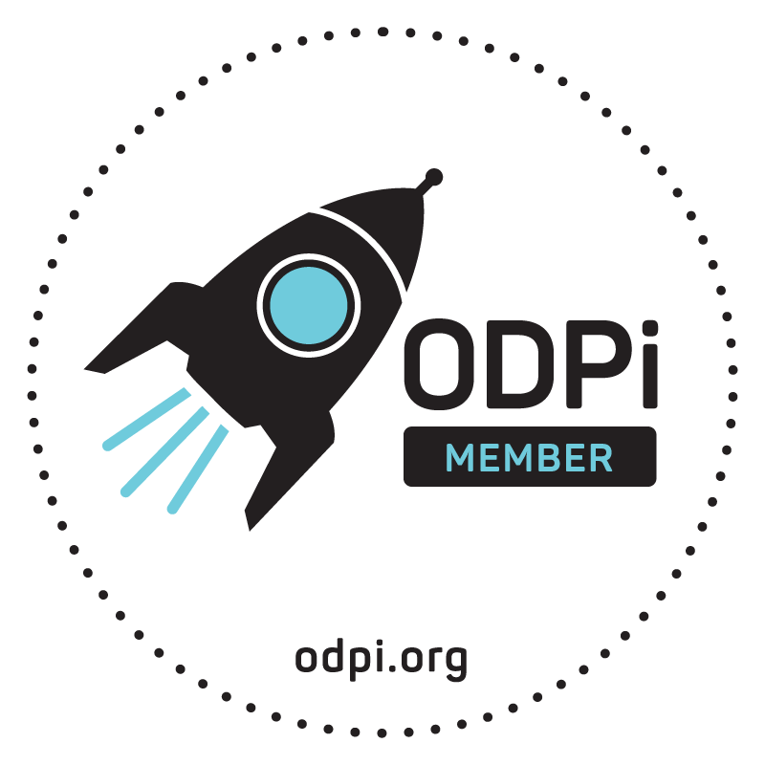


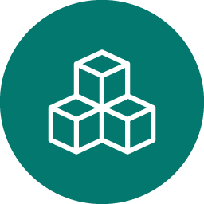
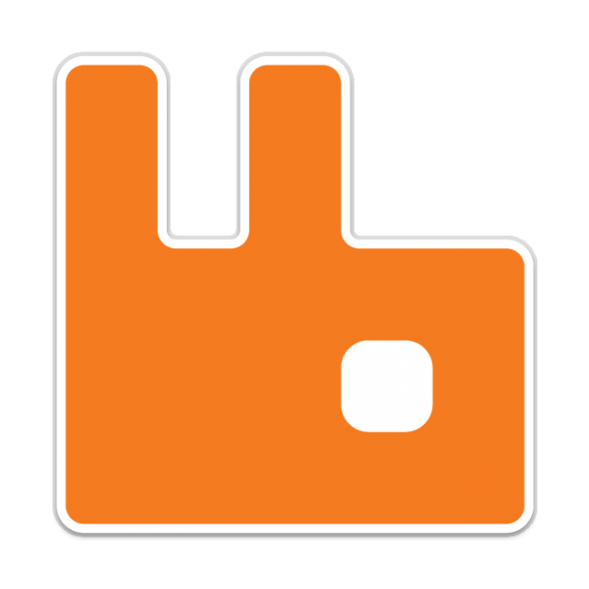
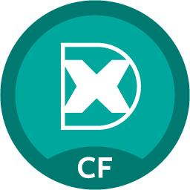
Pivotal Big Data Suite
Complete platform
+10 years of maturity
Open source only – Our DNA
Only one single SKU
PIVOTAL APACHE HAWQ
SQL analytical database for Apache Hadoop
(Apache licensing)
PIVOTAL GREENPLUM DATABASE
High Performance Analytics SQL database
(PostGres licensing)
PIVOTAL GEMFIRE
In-memory & transaction database
(Apache licensing)
Deployment options
Advanced data services
Spring XD
Ingestion and streams orchestration at scale
Rabbit MQ
Agile messaging at scale
Notes:
Pivotal Big Data Suite is the World’s First Open Sourced Big Data Portfolio!
Pivotal has open –sourced or will Open source all Pivotal Big Data Suite components including:
Pivotal Greenplum Database - will be open sourced by the end of this year.
Pivotal HDB- announced today (this week) now part of Apache as Apache HAWQ (incubating) and
Pivotal GemFire -premium in-memory NoSQL database , now part of Apache as Apache Geode
This powerful suite comprises all the necessary database tools to build any class of data-driven application and deliver unique and intelligent customer experiences.
But how will I be sure that my Hadoop Application will run within the current robust hadoop native eco-system?

Slide 30
Modern Cloud-Native Data Architecture
Apps & Microservices
Relational DB
K/V Store
DBMS
IMDG
Data Programming Model
Stream Data Platform
Platform Runtime
Microservices Framework
Hadoop
Spark
DW
Cloud-Native Platform
Big Data & Machine Learning

Slide 31
Deep dive
Pivotal Cloud Foundry
Notes:
I want to talk to you about cloud native applications, and bringing microservice architectures into production in the enterprise.

